Slide 1
The BEE’S KNEES

Slide 2
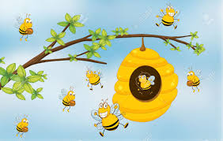
Problem OVERVIEW
The Problem we tried to solve was how to model a Beehive
In particular: how a collection of relatively simple creatures combine in a complex manner to produce honey
Beehive consists of many individual agents, performing differing roles
We also wanted to model the interaction of a bee keeper within this environment

Slide 3
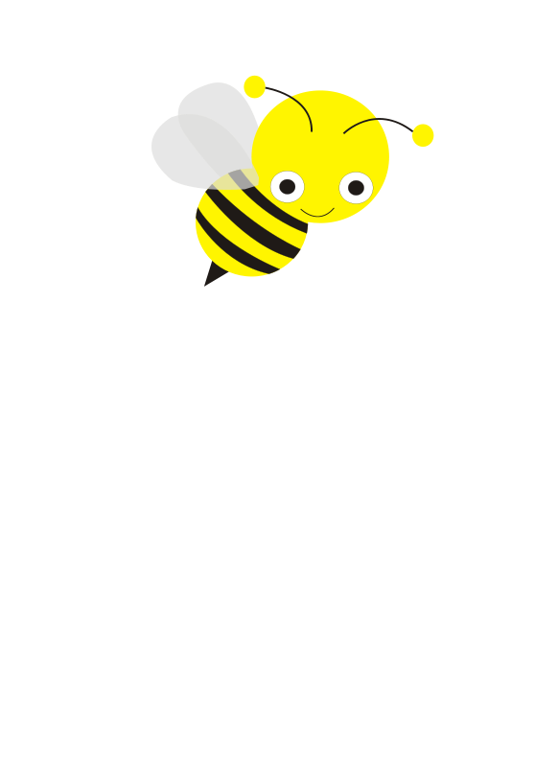
SOLUTION OVERVIEW
We used the GAIA methodology to model the hierarchy of the Beehive
From the Queen Bee down to the Larvae, including bee keeper and pollen producing flowers
We defined the various roles which need to be filled
As well as the agents which carried out those roles
And the Interactions between them

Slide 4
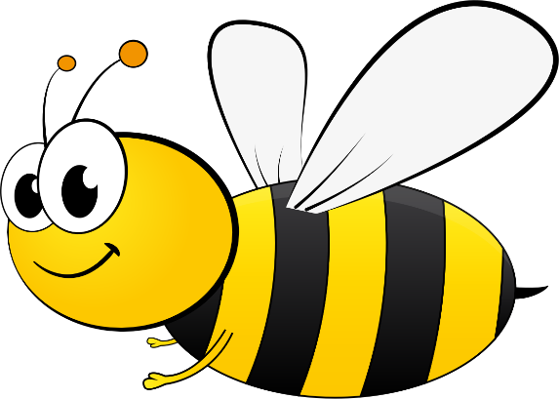
design OVERVIEW
Kept things as simple as possible, so we modelled:
The collection of pollen and nectar
Defence of the hive by bees and keeper
Creation of new bees
Feeding of larvae
Collection of honey by the bee keeper
Honey is implicitly created when nectar is brought back
to hive

Slide 5
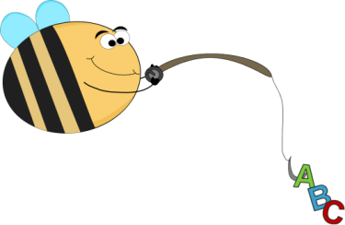
ACQUAINTANCE MODEL
Beekeeper Agent
Maintain Beehive
Beehive Agent
Worker Agent
Queen Agent
Mate with
Queen
Drone Agent
Collect
nectar
Feed
Larvae
Larvae Agent
Produce
Larvae
Flower Agent
Lay Drone Eggs

Slide 6
Our design - Roles
We created Roles for each unique job which must be carried
out in the beehive:
Honey Extractor
Maintainer
Honey Packager
Hive Guard
Honey holder
Pollen Producer
Bee Producing
Colony Builder
Egg Layer
Colony Defender
Pollen Collector
Larvae Feeder
Mate with Queen
Bee Producing
Colony Builder

Slide 7
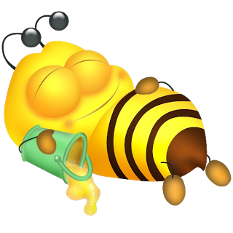
Example role – pollen/nectar collector
This role’s job is to leave the hive and search for pollen and nectar
Brings it back to the hive
Agent who carries out this role: Worker Bee

Slide 8
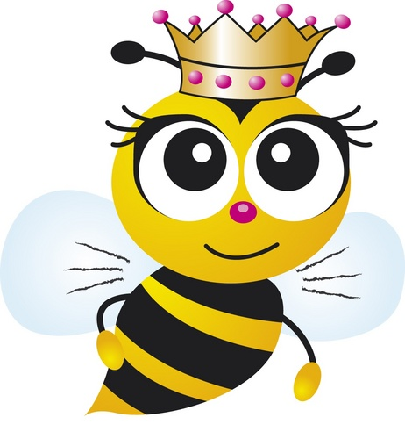
Example role – EGG LAYER
This role’s main job to keep the hive population growing by laying eggs
Also used to create the colony initially
Agent who carries out this role: Queen Bee

Slide 9
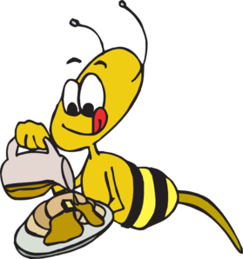
Example role – Larvae feeder
The role’s main job is to feed the larvae so that they grow and become new bee’s
Must make sure larvae hunger levels remain low
Agent who carries out this role: Worker Bee

Slide 10

Example role – Queen mater
The role’s job mate with the queen to produce larvae
Must compete with other drones to do this
Agent who carries out this role: Drone Bee

Slide 11
Agent
Model
Worker Agent
Colony Defender
Pollen Collector
Larvae Feeder
Beekeeper Agent
Drone Agent
Honey Extractor
Beehive Builder
Hive Guard
Honey Packager
Mate with Queen
Queen Agent
Flower Agent
Larvae Agent
Lay Eggs
Beehive Agent
Pollen Producer
Bee Producer
Honey Holder

Slide 12
conclusion
Although we tried to keep it simple, model quickly grew in complexity
Had to limit the behaviour and protocols in order to keep them manageable
This project demonstrates the usefulness of the GAIA methodology when in designing multi-agent systems

